Slide 1

Dining
Philosophers’ Problem
Authors: tom Antoniraj

Slide 2
Declaration
We are aware of the University policy on plagiarism in assignments and examinations
(3AS08)
We understand that plagiarism, collusion, and copying are grave and serious offences in
the Institute and We will accept the penalties that could be imposed if we engage in any
such activity.
This assignment, or any part of it, has not been previously submitted by me or any other
person for assessment on this or any other course of study.
We declare that this material, which We now submit for assessment, is entirely of my own
work and has not been taken from the work of others, save and to the extent that such
work has been cited and acknowledged within the text of my work.

Slide 3
Problem:
1. There are five philosophers sitting at a round table.
2. They cannot communicate with one another
3. There is only one chopstick between them but they need two to eat, or they’re not allowed to eat.
The Dining Philosophers Problem

Slide 4
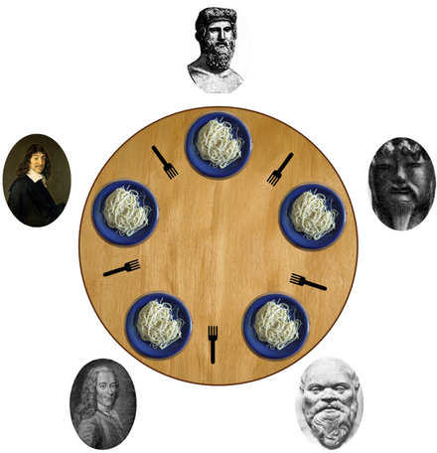
Key Points:
Deadlock: Each philosopher picks the chopstick up on their right side. They have to wait for the one of their left.
Starvation: Some philosophers get to eat while others may not, and others are kept waiting, some may not eat at all.
Concurrency Control: This allows the chopsticks to be accessed without troubles for the philosophers.
(Each have their own intervals for eating, some maybe be quicker or some my take longer)

Slide 5
We decided on the Mutex Locks. This is a mutual lock that gives one philosopher access to the chopsticks to eat.
Chopsticks are also known as a mutex.
After one eats, the chopsticks are placed back, allowing another philosopher to eat.
This can lead to deadlocks, making a philosopher hold onto a chopstick and not allowing another to eat, therefore making them wait.
Our Solution for the Topic
Dining Philosopher

Slide 6
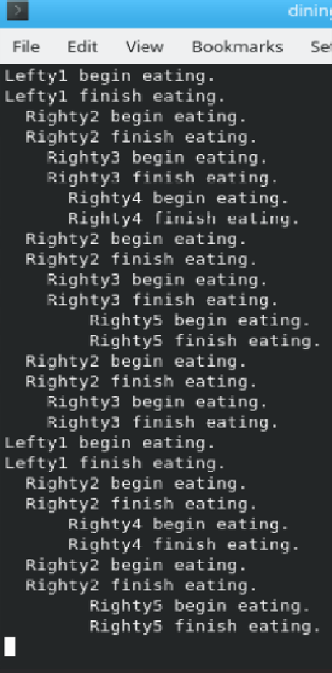
Code for the Mutex
----------------------------------------------------------
One begins to eat and finish within the same interval which allow one philosopher to go at a time.

Slide 7
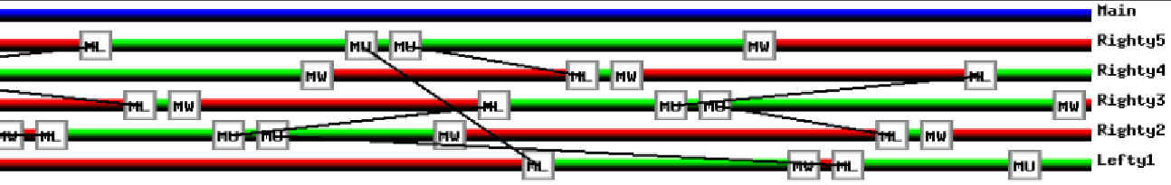
image showing the mutex & each philosopher

Slide 8
Code Meaning
ML = Mutex Lock: This interval makes the philosopher pick up a single chopstick.
MW = Mutex Wait: This would be where the philosopher would not be able to pick up a chopstick. (Maybe in use or unavailable to them).
MU = Mutex Unlock: This appears when the philosopher puts down his chopstick after eating.

Slide 9
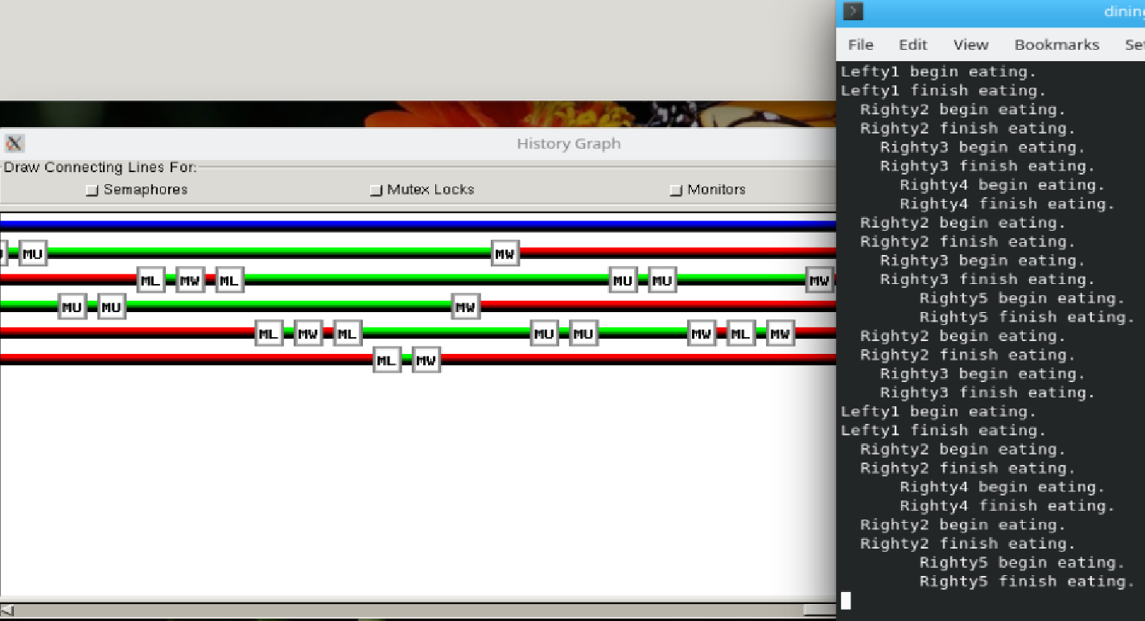
Code Show in the Konsole and in the Simulation

Slide 10
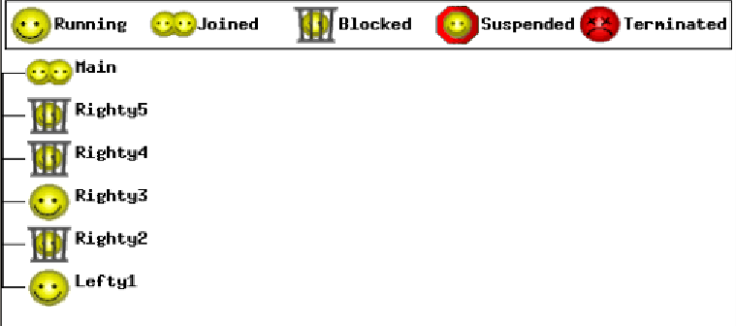
This shows the relationship of the philosophers in the simulation.
The philosophers are mostly shown in the Running (eating), Blocked (not eating), and Joined (started eating).
Thread Hierarchy

Slide 11
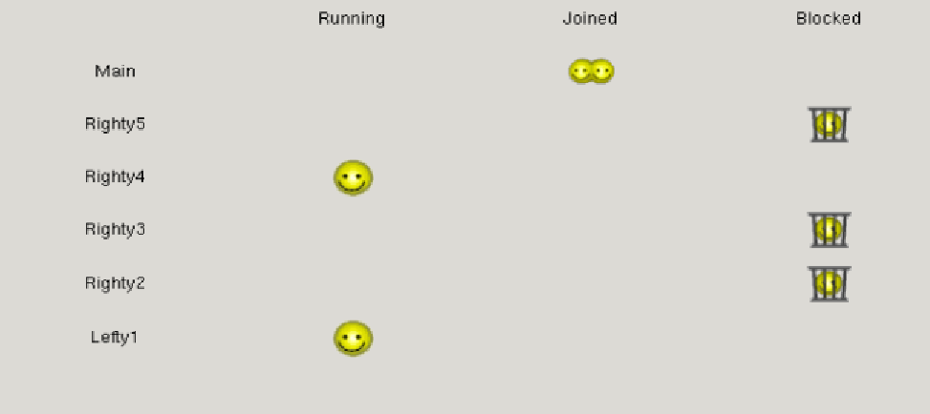
Thread Status
Related to the Thread Hierarchy. This is more simplified, showing the philosophers along with the main status.

Slide 12
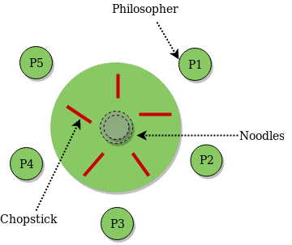
Issues with the Lefty-Right Solution?
Uneven Resource Allocation - Some philosophers might have a higher chance of eating based on their lefty or righty status because the system does not guarantee that all philosophers get an equal amount of time to eat.
Less Scalable for Larger Amounts of Philosophers - If the number of philosophers increases, the pattern might not be as effective. It could make some philosophers in the thread wait too long while others eat more frequently.
Doesn’t Prevent Starvation from Scheduling Issues - Even though deadlock is avoided, if the thread scheduling is unfair (some threads get priority due to the system), some philosophers might not be able to eat compared to others.

Slide 13
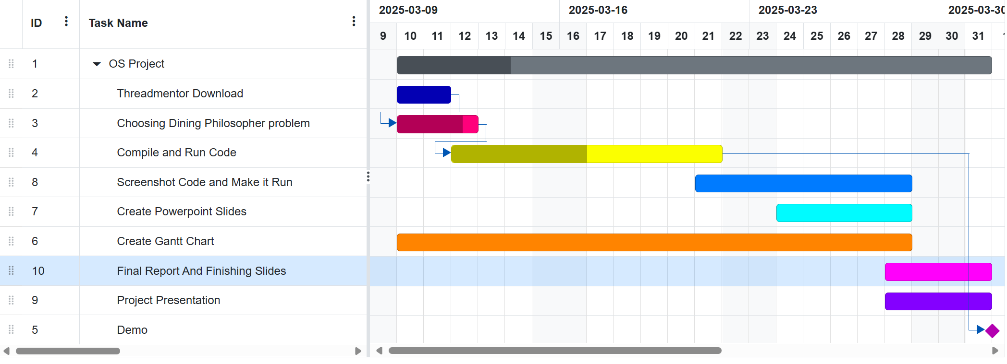
Gantt chart

